Slide 1

Netflix Subscribers and Movies/Series in United States and Canada 2018-2020
ETL Project - Brenda, Teresa, Marcela

Slide 2
Questions
What year has the most subscribers?
What are the most frequent ratings of movies/series available on Netflix?
What are the top selection categories (movies v. series) available on Netflix?

Slide 3

The Data
Source: Kaggle
Type: CSV
Netflix Title and Ratings (Netflix)
Netflix Subscriber (Subscriber)
Limitation
2020 - no 3rd or 4th quarter subscriber data

Slide 4
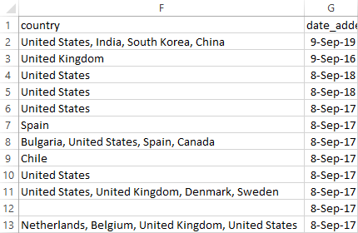
Data Clean-up - Netflix
Place countries into separate columns
Pull United States and Canada
Extract year from date_added
Used a split on countries
Notes:
Teresa will go more in depth in the transform slide

Slide 5
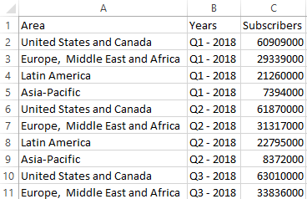
Data Clean-up - Subscribers
Extract year from quarter
Extract United States and Canada

Slide 6

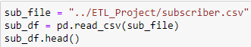
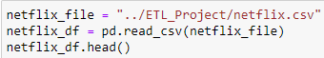
Extraction
CSV format
Put each CSV into a pandas DataFrame
Noted differences in CSV, number of columns and column names

Slide 7

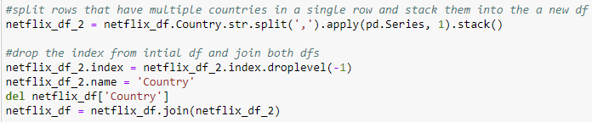
Transform
◆ Select years 2018-2020 in the Netflix csv
Created start and end date
Changed format to Datetime
◆ Rename columns to fit the tables created in the database.
◆ Copy only the columns needed into a new DataFrame.
◆ Dropped duplicates.

Slide 8
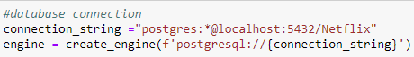
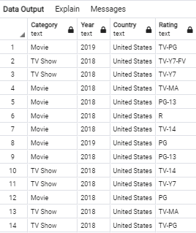
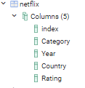
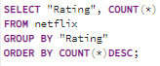
Load
◆ Created a connection to SQL.
◆ Confirmed that the tables were created and ran SELECT * on all.
◆ Appended DataFrames to tables.
● Created tables to answer all our questions.

Slide 9
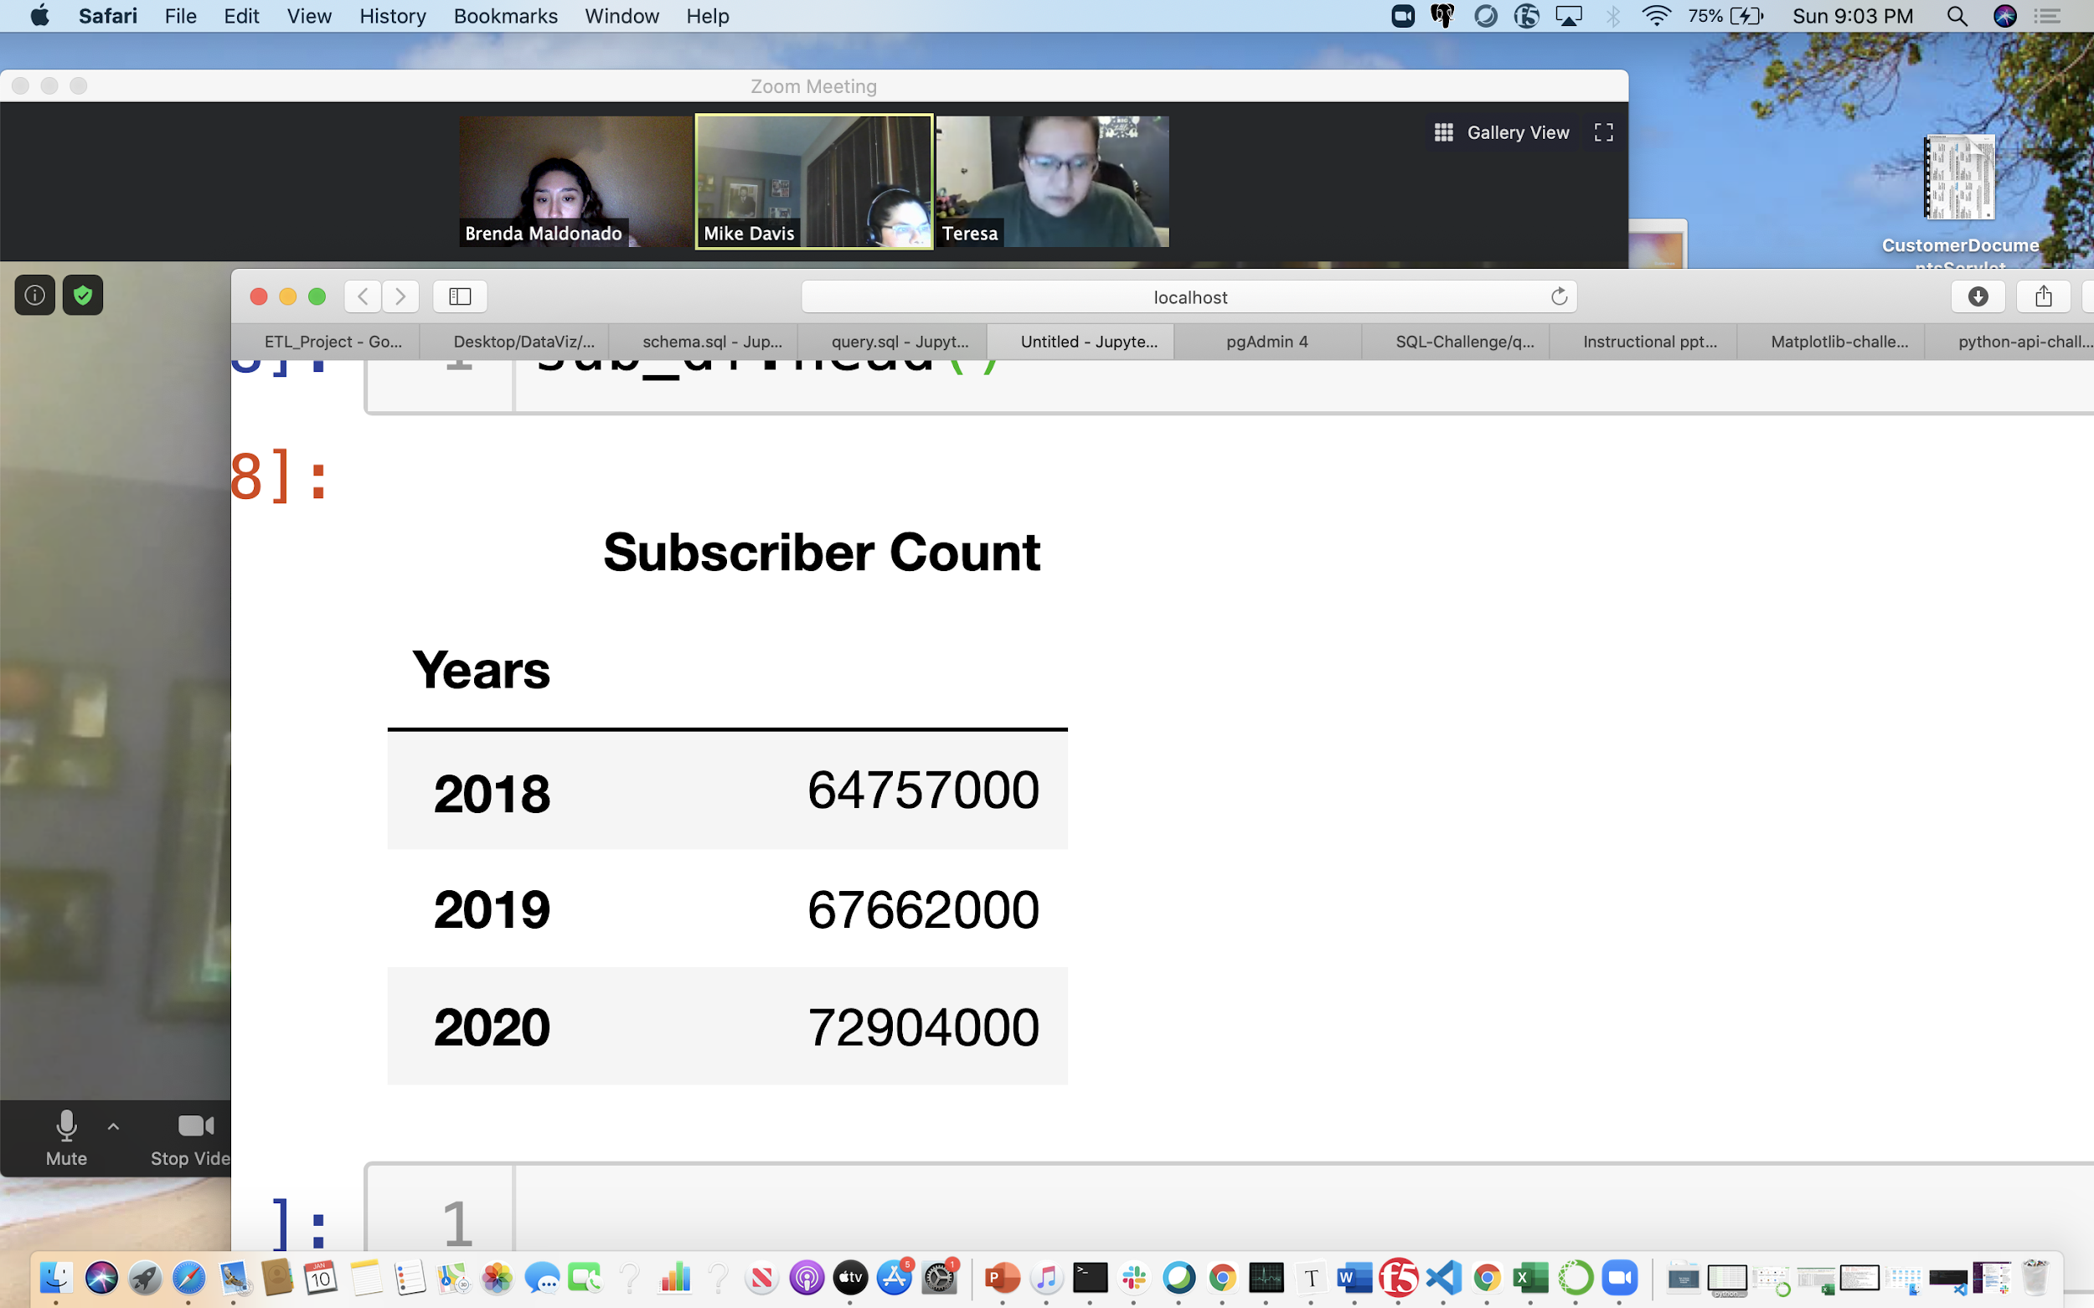
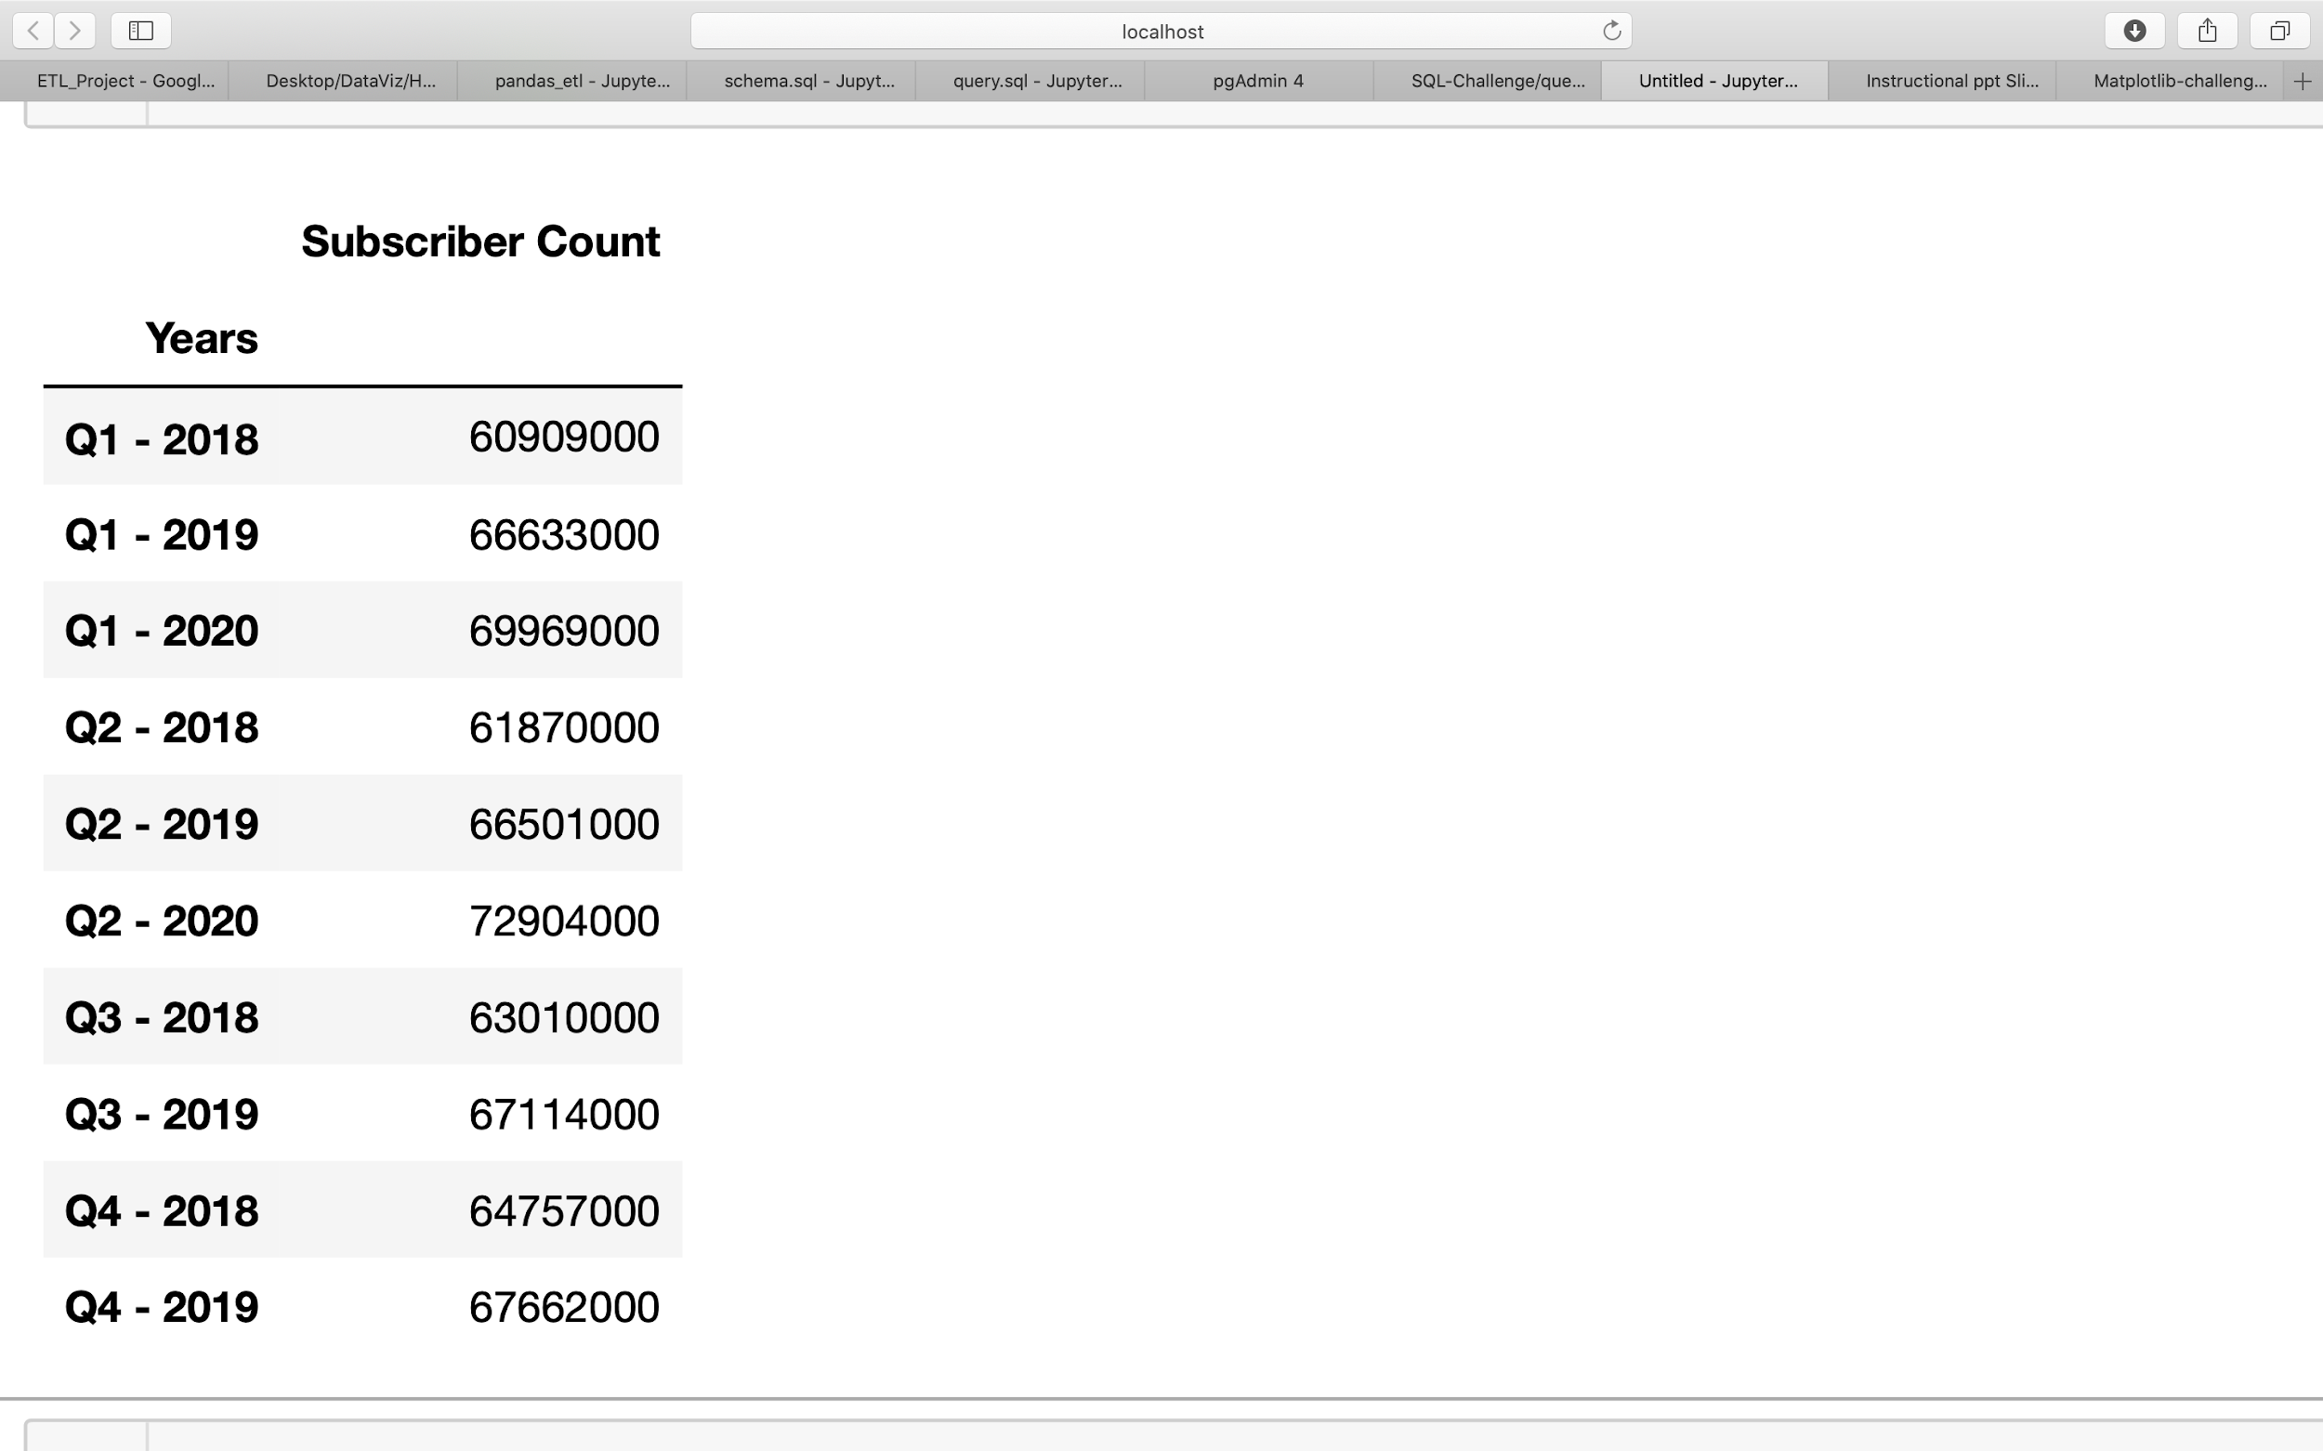
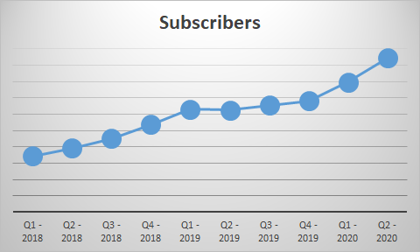
Data Analysis - Most Subscribers
Notes:
1st graph: Displays the quarters
Line graph: There were increases in all quarters for all years, except between Q1 and Q2 of 2019 where there was a slight decrease in subscribers.
2nd graph: Displays the most subscribers per year, 2020 resulting having the most subscribers
Fun facts: The number of Subscribers has grown from less than 22 million in 2011 to 150 million in 2019
https://www.statista.com/topics/842/netflix/

Slide 10
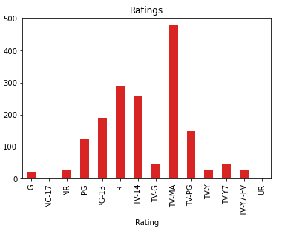

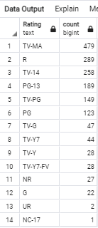
Data Analysis - Top Ratings Available
Notes:
TV-MA (For Mature Audience) May not be suitable for ages 17 and under.
R (Restricted) Under 17 Require Accompanying Parent or Adult Guardian
TV-14 (May not be suitable for ages 14 and under)
PG-13 (May be Inappropriate for ages 12 and under)
TV-PG ( can be viewed by younger audiences but shouldn't be seen without their parents in the room)
PG (Parental Guidance)
TV-G(Appropriate for all audiences)
TV-Y7(designed for chil- dren ages 7 and older)
TV-Y(appropriate for children of all ages)
TV-Y7-FV (indicate that a program contains “fantasy violence” that may be more intense)
NR (Not Rated)
G (General Audiance)
UR (Un-rated)
NC-17 (anyone below the age of 17 is not allowed to watch a film)

Slide 11

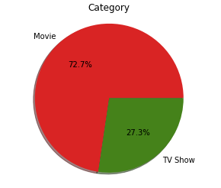
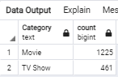
Data Analysis - Top Selection Types

Slide 12



Conclusions
2020 has the most subscribers (72,904,000).
Most of the shows/movies available are for “mature audiences.”
There are more movies on Netflix than TV shows.
Don’t leave your children unattended with Netflix!
Notes:
This is even considering the Q3 and Q4 2020 data.
Fun facts: The number of Subscribers has grown from less than 22 million in 2011 to 150 million in 2019

Slide 13

SAY WHAT AGAIN #*!&#$*@!
Any Questions?

